Slide 1



Course: Image Processing 31651 Assignment #12 Synthetic Image Creation (Part 2) – version 2
1
Photo of the student | Shorten Name | ID (4 last digits)
 | shienfeld | 1950 | Student #1
 | pony | 2210 | Student #2
 | akimov | 7939 | Student #3

Slide 2
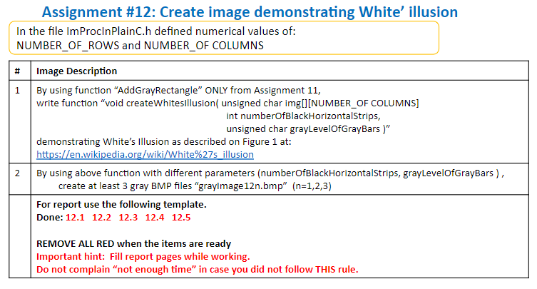

Slide 3
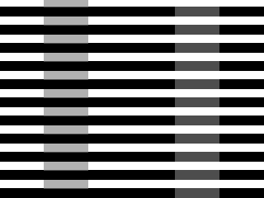
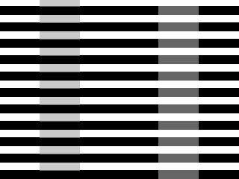
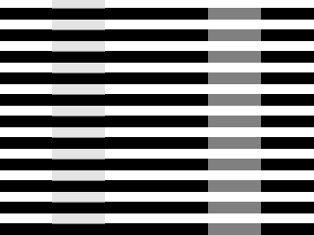
12.1 our resulted images “grayImage12n.bmp” with add short comment– part 1
3
grayImage121.bmp
grayImage122.bmp
grayImage123.bmp

Slide 4
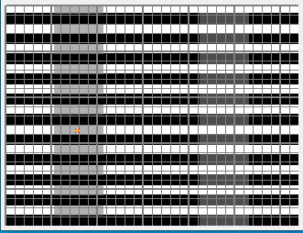
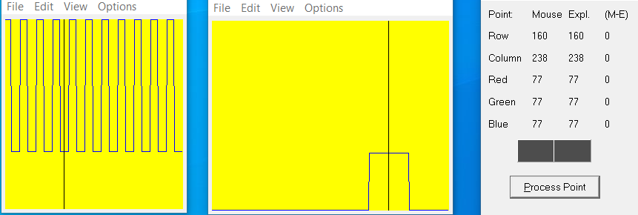
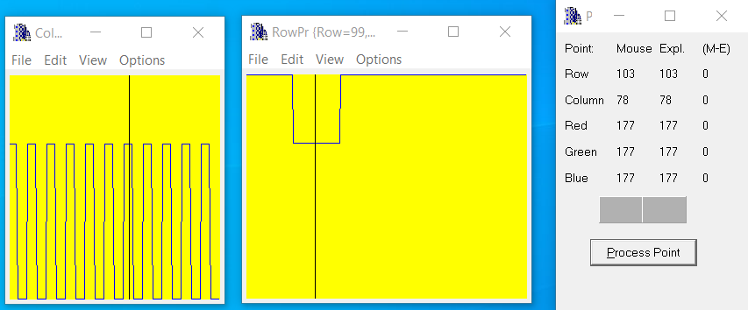
grayImage121.bmp
12.2 Relevant Profiles – part 1/3
4
2
1
2
We present two points and their profiles. We can see that the first point has gray level of 177 (medium level) and the second point of 77 (low level).
The row and column views show the periodic pattern in the column view , and the step pattern in the row view
1

Slide 5
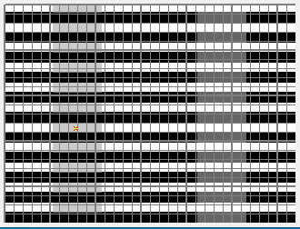
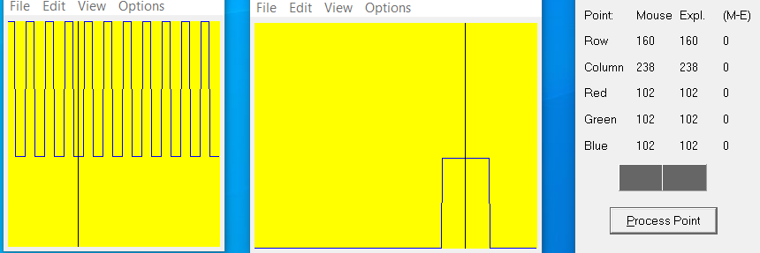

grayImage122.bmp
12.2 Relevant Profiles – part 2/3
5
2
1
2
We present two points and their profiles. We can see that the first point has gray level of 202 (medium-high level) and the second point of 102 (low-medium level).
The row and column views show the periodic pattern in the column view , and the step pattern in the row view
1

Slide 6
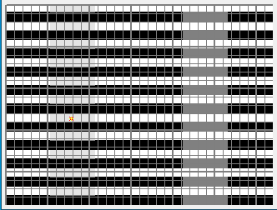
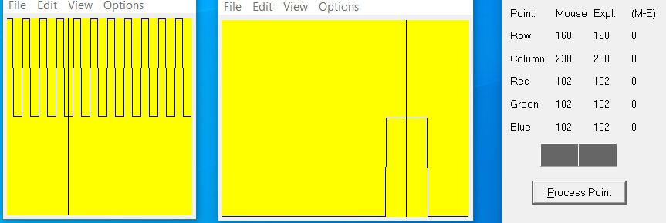
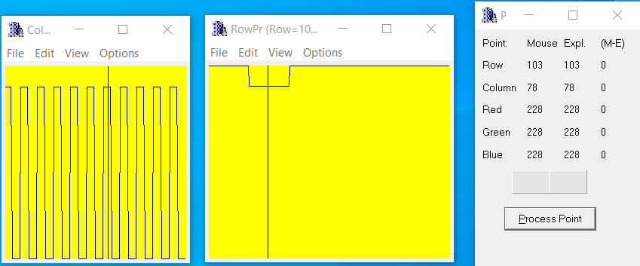
12.2 Relevant Profiles – part 3/3
6
grayImage123.bmp
2
2
1
We present two points and their profiles. We can see that the first point has gray level of 228 (high level) and the second point of 102 (low-medium level).
The row and column views show the periodic pattern in the column view , and the step pattern in the row view
1

Slide 7
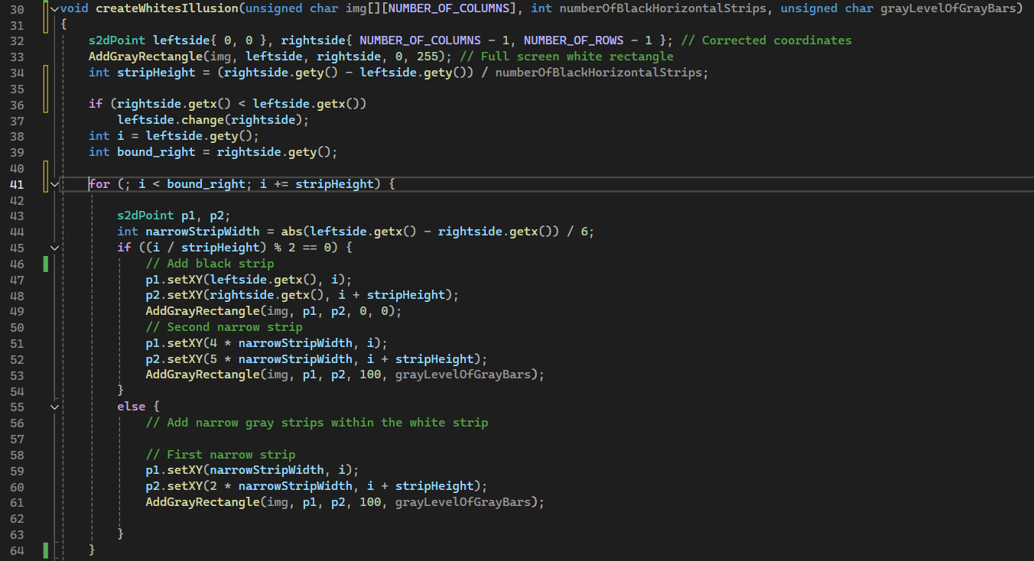
12.3 Code of the function “createWhitesIllusion” – part 1/3
7
The function starts by filling the entire image with a white background. It then calculates the height of each black strip based on the total number of strips specified.
The function iterates over the image height, adding black strips for even indexed rows and narrow gray bars within both the black and white strips, adjusting their positions accordingly.
This is done using the AddGrayRectangle function, which ensures the correct placement and shading of the rectangles, creating an illusion where the gray bars appear differently depending on their background.

Slide 8
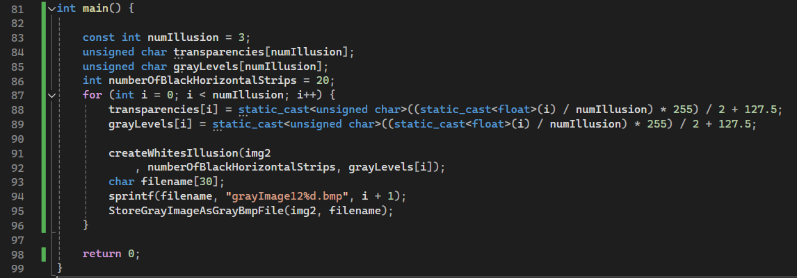
12.4 Code of the main function
8
The main function initializes parameters for creating multiple versions of White's Illusion on an image.
It defines the number of illusions to be created, sets transparency and gray level values for each, and iterates to generate these illusions using the createWhitesIllusion function.
After creating each illusion, it saves the resulting image as a BMP file with a unique filename. This process is repeated for each set of transparency and gray level values to produce and store multiple images demonstrating the illusion.

Slide 9
12.5 What did we learned ?
9
understand how grayscale images are represented and manipulated, using values from 0 (black) to 255 (white).
Learn how to blend different transparency levels and gray levels to create visual effects.
Apply geometric concepts to determine the positions and dimensions of shapes within an image.
Understand techniques for generating dynamic filenames to save multiple output files.

